Slide 1

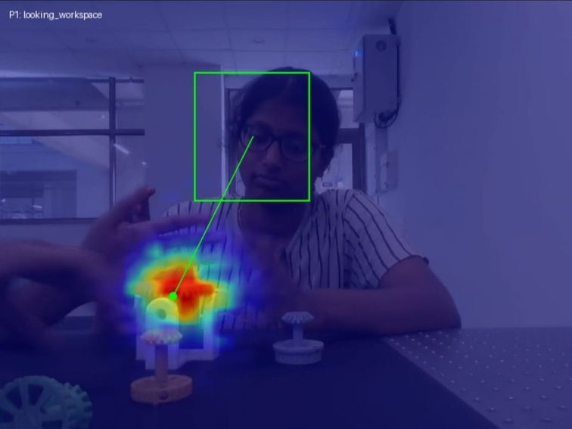
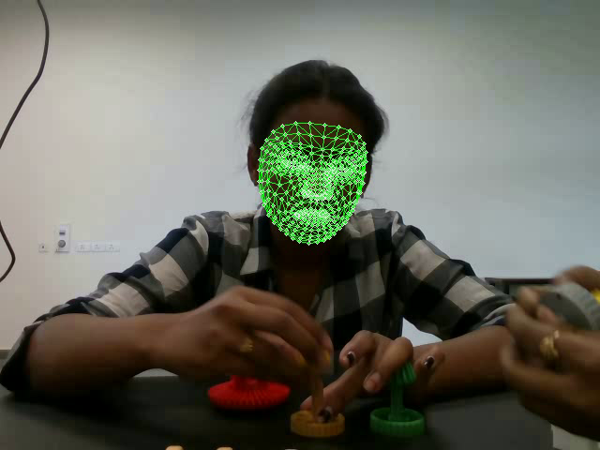
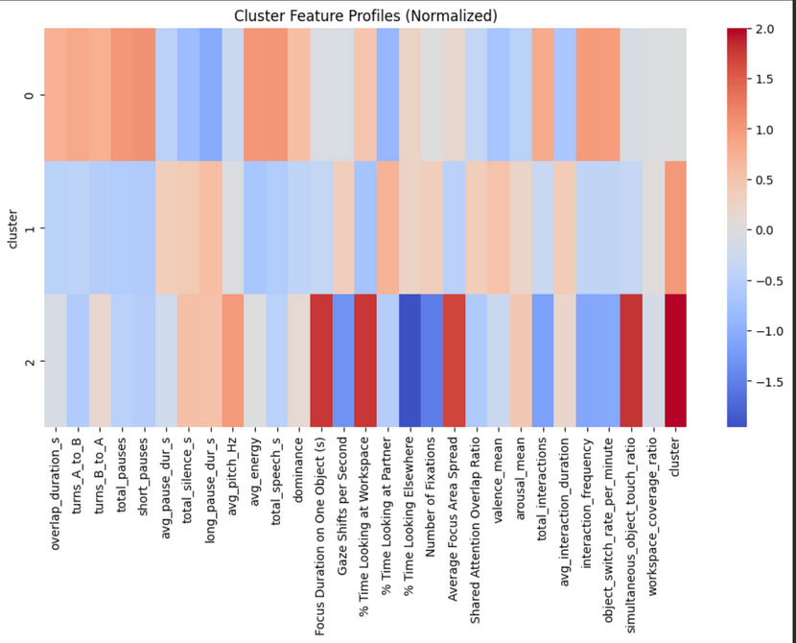
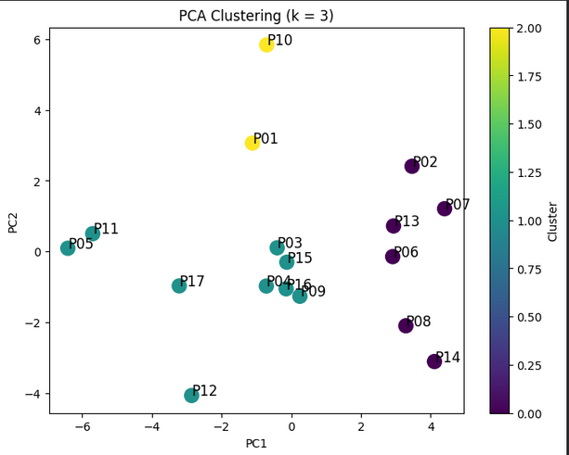
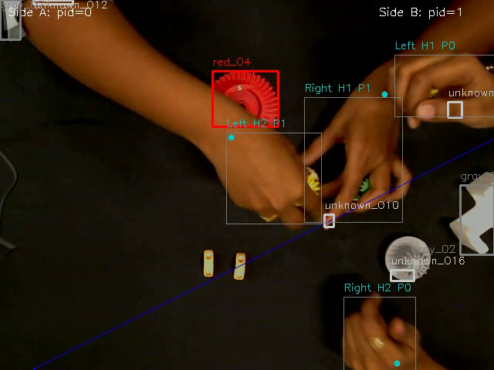
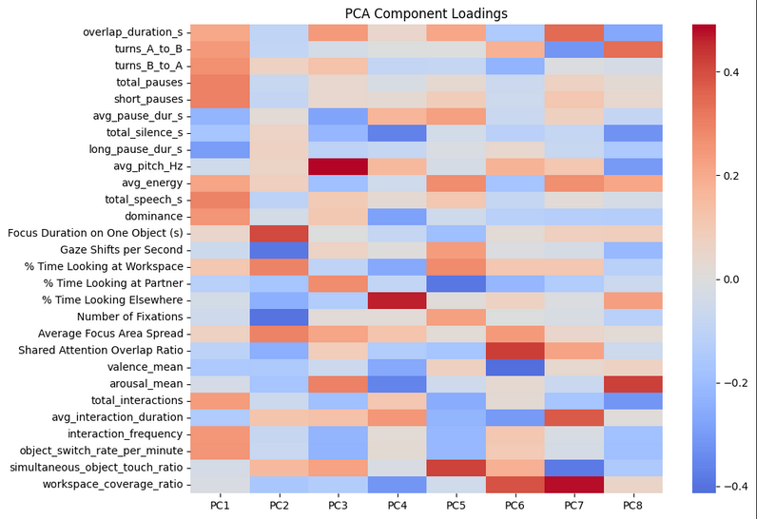
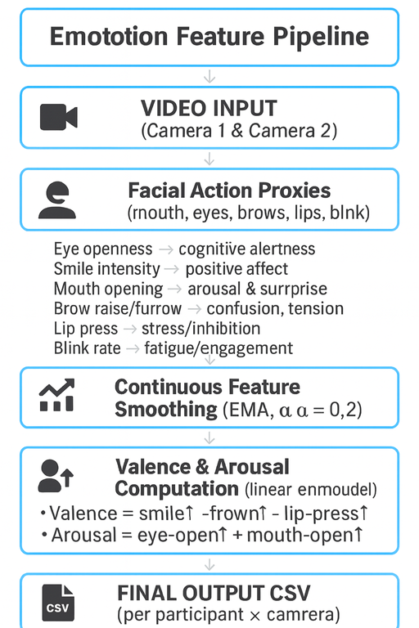
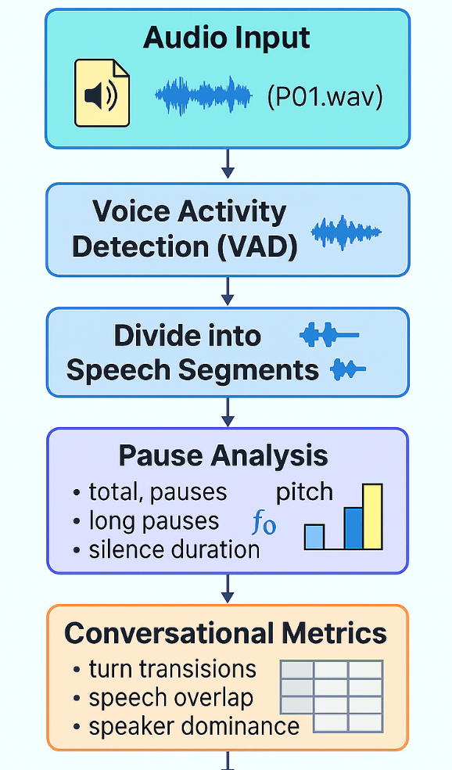
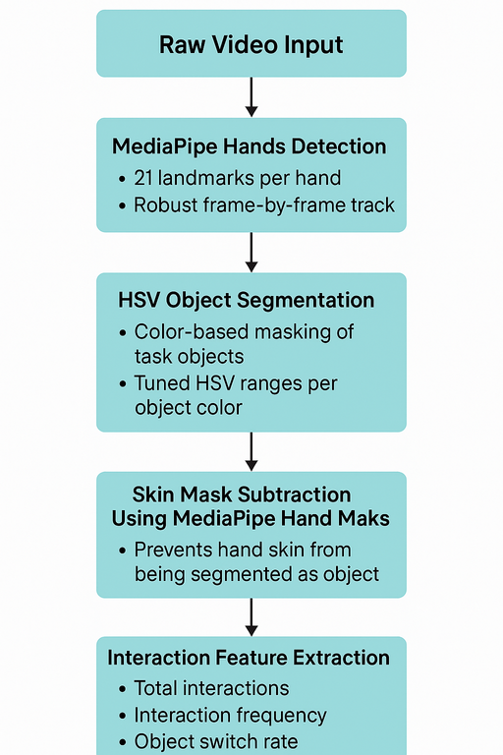
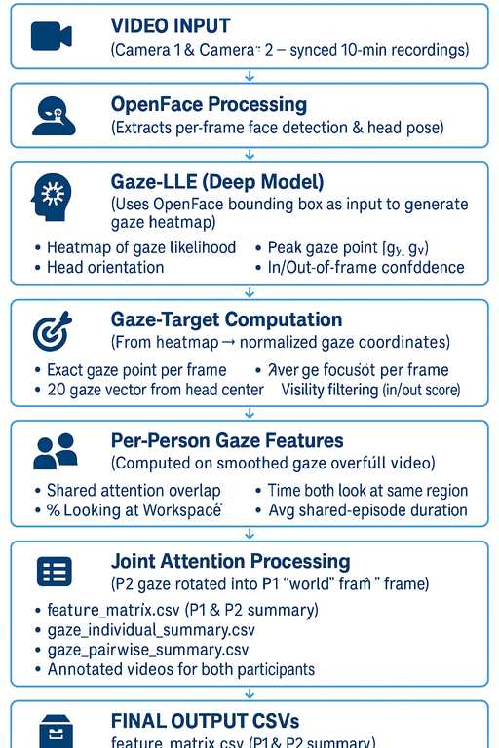
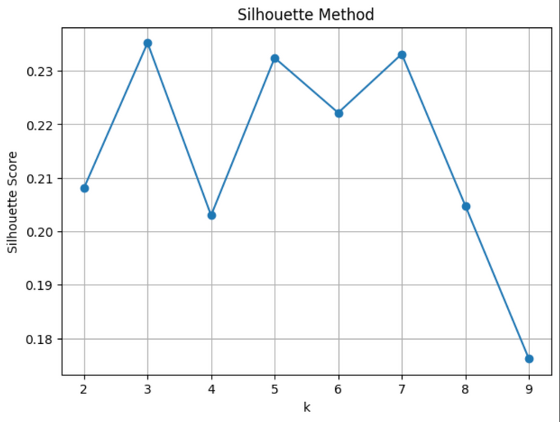
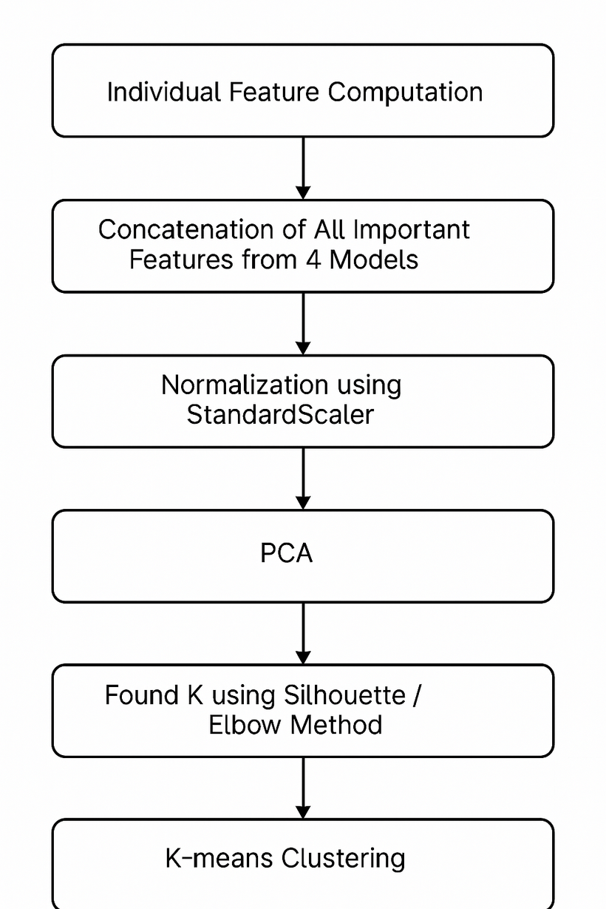
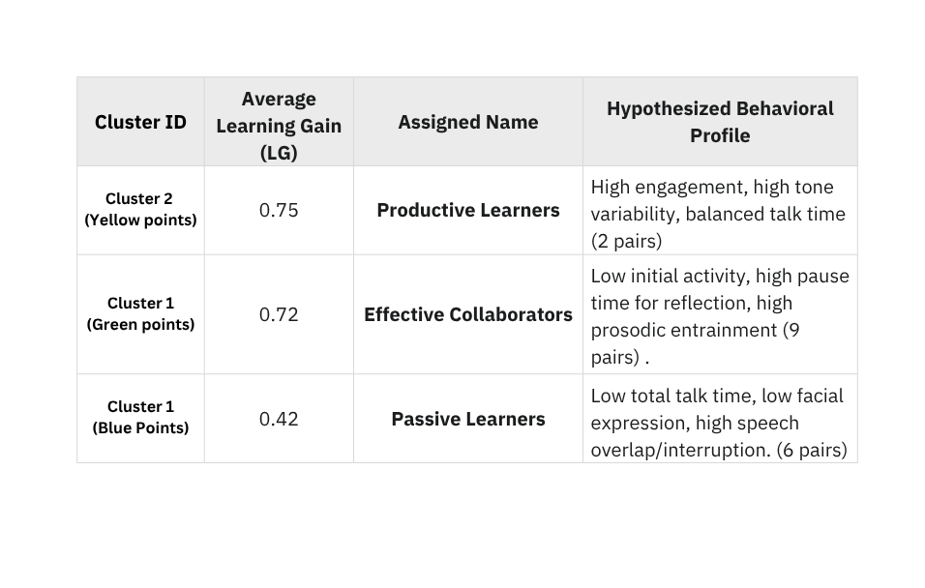
Multimodel Analytics of Collaborative Learning Activities
IIT Gandhinagar
Under the
Supervision of
Indian Institute of
Technology Gandhinagar
Prof. Aditi Kothiyal
aditi.kothiyal@iitgn.ac.in
Makkena Lakshmi Manasa
makkena.manasa@iitgn.ac.in
Siju Niyati Samji
niyati.siju@iitgn.ac.in
Rushitha Thipparapu
rushitha.thipparapu@iitgn.ac.in
Introdution
Results
Experimental Results
Experimental Results
Collaborative learning activities are rich, multimodal interactions that demonstrate how partners coordinate and communicate.
Understanding these behaviours helps identify productive teamwork.
We analysed audio-video recordings of 17 pairs in a hands-on
open-ended task.
Four modalities are used: emotions, gaze, hand movements, and speech.
Together, they capture the quality of engagement and interaction.
Features are normalised and reduced with PCA to highlight key patterns.
Clustering uncovers distinct collaboration profiles among pairs.
This offers a data-driven approach to characterise effective collaboration.
Implementation
Figure 1: Eye gaze heat map
Figure 2: Media pipe facial Landmarks
Figure 5: Final Clusters and their avg. LG
Challenges Faced
Figure 3: Bounding boxes on objects
Hand & Object Actions
YOLO struggled with small colored objects.
Hand interactions (reach/touch/grasp) were hard to classify due to occlusions and
varied hand poses.
Eye Gaze
Slow face detection and high GPU load affected tracking.
Speech
Background noise and overlapping speech.
Emotion/tone cues are hard to capture; audio–video sync is required.
Getting an accurate transcript without ground truth
Emotions
Struggling with OpenFace Installation on GPU system
Figure 4: Methodology used for Emotions, Audio, Hand moment and Eye gaze respectively
Feature Matrix Calculation
Speech features
Short pause duration < 5 seconds
Long pause duration >= 10 seconds
Total Speech = Σ (end − start)
Total Silence Duration = Σ (NextStart − PrevEnd)
Dominance = Speech_A / (Speech_A + Speech_B)
Overlap = Σ intersection(SpeechA, SpeechB)
Mean Pitch = Average(Pitch across voiced segments)
Mean Energy = Average(Signal² / Length)
Future Work
Figure 6: Deciding the K value
Figure 7: Flow of the Project
Add more modalities (posture, facial cues, task metrics).
Use advanced clustering to find deeper learner patterns.
Train supervised models to predict learning gain from multimodal signals.
Test on larger, diverse datasets for stronger validation.
Eye Gaze features calculation
Focus Duration on One Object=mean fixation duration over all fixations
Fixation Duration=1/N​ ∑​(endk​−startk​)
Average duration of fixation segments (gaze staying within radius 0.03)
Gaze Shifts per Second=Number of gaze shifts​/Video duration (sec)
% Time Looking at Workspace = (frames looking_workspace)/total frames ×100
% Time Looking at Partner = (frames looking_to_partner)​/total frames ×100
%Elsewhere=100−(%WS+%Partner)
Number of Fixations =no of segments where fixation duration is greater than zero.
Spread = average distance between points in a fixation and its centroid
Shared Attention Overlap Ratio IoU = Overlapping attention area ÷ Total attention area
IoU=∣H1​∩H2​∣/∣H1​∪H2​∣​
Arousal Calculation is a weighted combination produces the score:
arousal = 0.55·eye_open + 0.45·mouth_open.
Valence = = 0.65·smile − 0.25·brow_relax − 0.10·lip_press.
References
Hand Movement feature
total_interactions = count(hand–object distance < threshold)
avg_interaction_duration = mean(duration of_continuous_contact_sequences)
interaction_frequency = total_interactions / total_time_minutes
object_switch_rate = num object ID transitions / total_time_minutes
simultaneous_touch_ratio = frames both hands touching / total_frames
workspace_coverage = area(hand centroid path) / total_workspace_area
[1] Nasir, J., Kothiyal, A., Bruno, B. et al. Many are the ways to learn identifying multi-modal behavioral profiles of collaborative learning in constructivist activities. Intern. J. Comput.-Support. Collab. Learn 16, 485–523 (2021). https://doi.org/10.1007/s11412-021-09358-2
[2] https://openface-api.readthedocs.io/
[3] https://mediapipe.readthedocs.io/
[4] https://github.com/fkryan/gazelle
[5] https://github.com/snakers4/silero-vad

